Slide 1

Makes network management easier
Can’t wait to explore yaNMS?
github.com/yanms

Slide 2
Project NMS: test phase
Remy Bien
Sebastiaan Groot
Wouter Miltenburg
Koen Veelenturf

Slide 3
Content
Overview
Introduction
yaNMS (wasn’t it NMS?)
Phases
Scope & MoSCoW
Application
Code status (HTTP/1.1 200 OK, so far so good)
Coding errors (it happens, even to us)
XML-files
Juniper
Cisco
Documentation:
Whitepaper
System Documentation
System Management Documentation
Test Plan

Slide 4
Introduction yaNMS/NMS… what is the difference?

Slide 5
yaNMS
Why we changed the name
NMS already exists
yaNMS (yet another Network Management System)
Phases
Phase 1
Design phase
Phase 2
Development phase (mostly feature implementations)
Phase 3
Test Phase (XML files, debugging, documentation)

Slide 6
Scope & Moscow
Must
The system must support CISCO devices;
The system must be able to open or shutdown network ports;
The system must make use of a database such as SQlite;
The system must have pluggable support.
Should
The backend should be python based;
The system should have multi-vendor support;
The system should have a nice modern looking interface;
The system should support user authentication.
Could
The system could have ACL (access control list) rules;
The system could have multi database support;
The system could have an auto-detection mechanism (e.g. OS version).
Won’t
The system won’t have multi-language support.

Slide 7
Application GET /install HTTP/1.1

Slide 8
Code status
New features:
Implemented shared memory
XML-file uploader and validation
Two weeks ago we issued a code stop
Only changing code for debugging purposes
All features are implemented according to earlier documentation and MoSCoW

Slide 9
Coding errors
Testreport showed that there were multiple bugs
Fixed all bugs that were known during testing
Most of them were:
Input validation errors
Refresh buttons
Caused by earlier code changes and not changing the code for the refresh button
Wrong field/input names
User sessions not removed when deleting user
If a user was deleted, sessions were still active and user could login whenever a new account was created.
High risk issue: Fixed this by removing all sessions whenever a user is deleted

Slide 10
XML files Is your device supported?

Slide 11
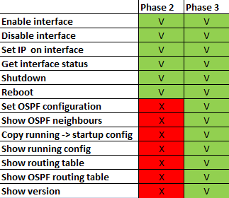


XML files
Cisco C3660
Cisco
Juniper

Slide 12

Documentation Get some trees

Slide 13
Documentation
Whitepaper
System documentation
System Management Documentation
Test Plan
Can’t wait to read our documentation?
github.com/yanms/nms_documentation

Slide 14
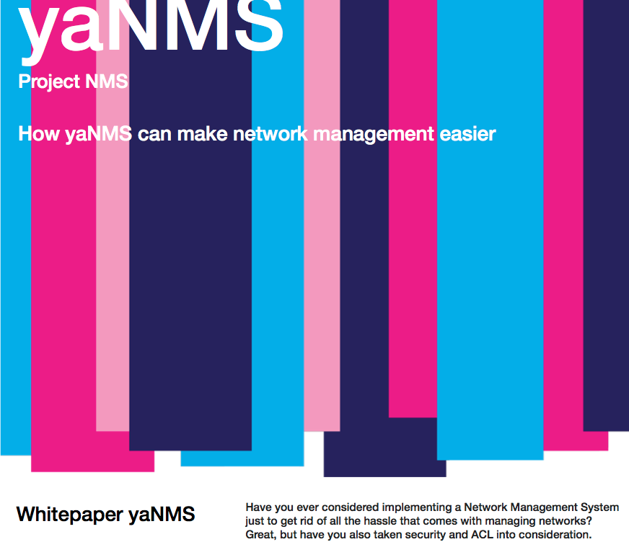
Whitepaper

Slide 15


System documentation
15

Slide 16
System Documentation (cont.)
Reference for developers on yaNMS
Function and class description in python documentation style
Examples for multiple development tasks

Slide 17

System Management Documentation

Slide 18
Test plan
Test Plan
Functional Tests
Test Results
Some Fails, some side notes
Bugfixes

Slide 19
Project Network Management System (yaNMS)
Any Questions?

